Slide 1


Data Visualization
Data Analytics Bootcamp
XBUS 400.04 — Summer 2021

Slide 2


Slide 3

Kristen McIntyre
Machine Learning Engineer, Booz Allen Hamilton
Poster Committee Chair, Python Software Foundation
Core Contributor, Yellowbrick
Email: kam452@georgetown.edu
LinkedIn: linkedin.com/in/kristenmcintyre1
GitHub: https://github.com/Kautumn06
Twitter: https://twitter.com/Kautumn06

Slide 4
Course Logistics
Canvas
PowerPoint slides
Syllabus
Homework
Additional Resources
GitHub repository
Course repository
Datasets
Jupyter notebooks
Python packages
Clone the GitHub repository
Download files from Canvas
Install and/or update the necessary Python libraries
Office Hours
Sundays, 3:00 p.m. – 5:00 p.m.

Slide 5
Week 1 — Friday Evening (6:30 pm – 7:30 pm)
Why data visualization and storytelling are important
Python visualization libraries & other data visualization tools
Importance of matplotlib and the differences between its two main interfaces

Slide 6
What is Data Visualization?
“Graphics should not simplify messages. They should clarify them, highlight trends, uncover patterns, and reveal realities not visible before.” — Alberto Cairo
Explanatory Visualization
Data visualizations that tell a story and are designed for your audience
Is done at the end of the project or analysis
Exploratory Data Analysis (EDA)
Main type of data visualization
Should begin as soon as you receive your raw data
Human visual analysis can uncover patterns and pitfalls that would be otherwise missed

Slide 7
A Brief History of Data Visualization

Slide 8
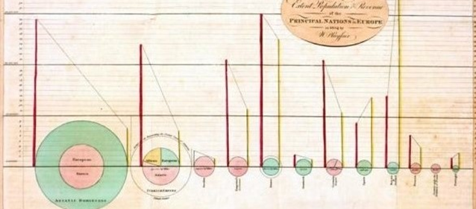
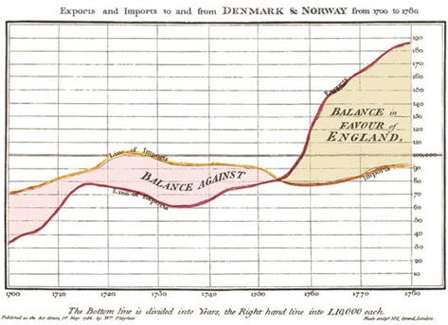
William Playfair (1759–1823)
18th–19th Century
Scottish engineer and political economist
Founder of graphical methods of statistics
Created the time-series line graph, bar chart, and pie chart.
Images used under the Wikipedia Creative Commons license. http://www.wikipedia.com

Slide 9
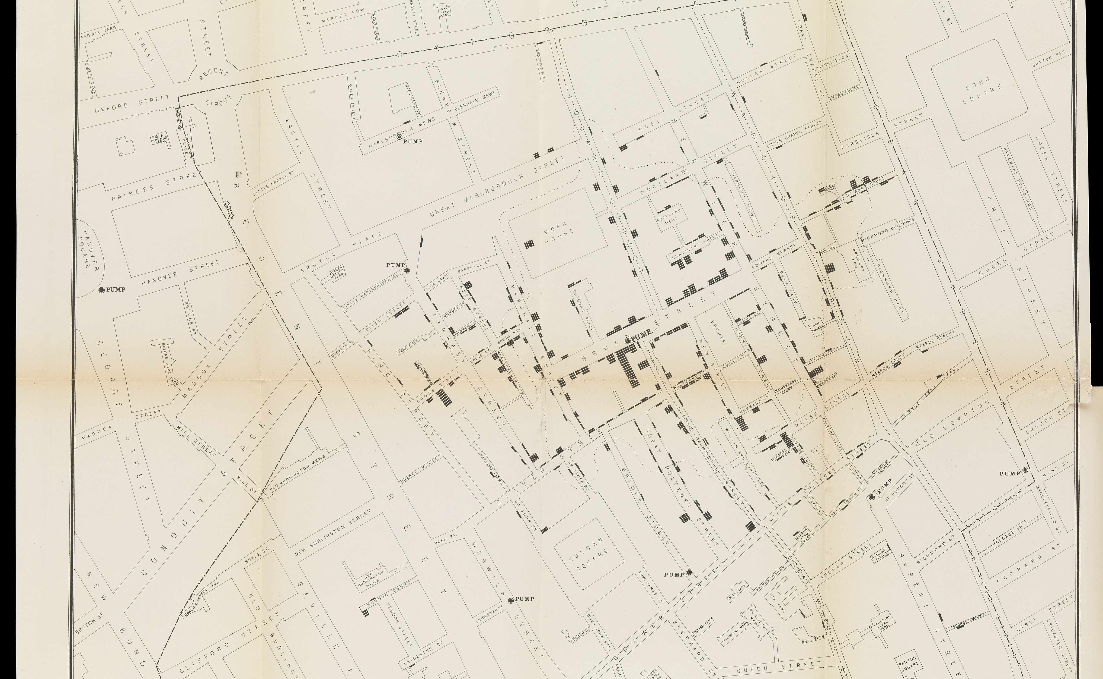
John Snow’s Cholera Map (1854)
Notes:
In 1854, Britain’s Soho neighborhood in London suffered a severe outbreak of cholera.
At the time, the assumption was that the illness was airborne. However, British physician John Snow began tracking the locations of the different outbreaks by placing a point on the map each time someone died from the disease.

Slide 10
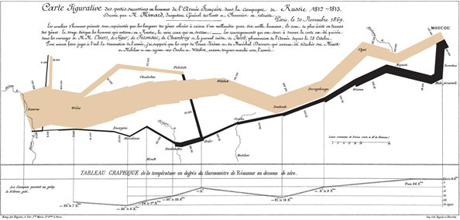
19th Century
Notes:
Charles Minard was a French civil engineer (1781-1870)
Map of Napoleon’s 1812 Russian campaign, the “Figurative map of the successive losses of men of the French army in the Russian Campaign 1812-1813”, is regarded as one of the best statistical graphics ever drawn.
In two dimensions, it includes six types of data: the number of troops in Napoleon's army, distance, temperature, latitude and longitude, direction of travel, and location relative to specific dates.

Slide 11
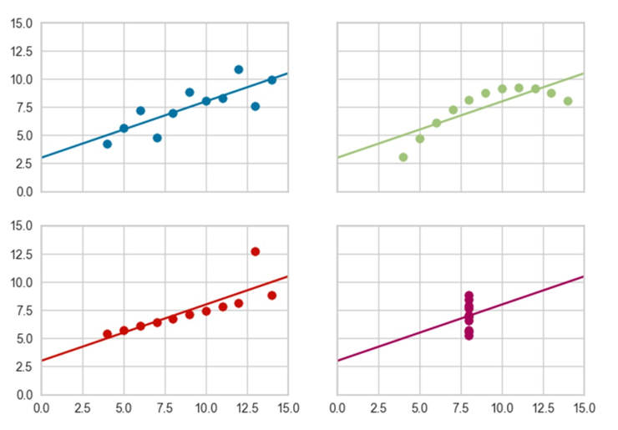
Anscombe’s Quartet
Notes:
In 1973, English statistician Francis Anscombe published an article, “Graphs in Statistical Analysis”, where he argued that visualizing your data was essential element of statistical analysis.
He created four fictitious datasets that had nearly identical simple descriptive statistics. However, by visualizing them, we can quickly see the differences.

Slide 12
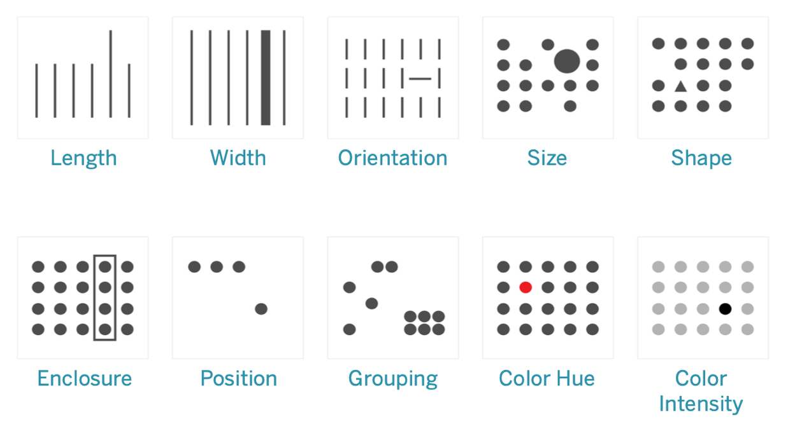
Preattentive Attributes

Slide 13
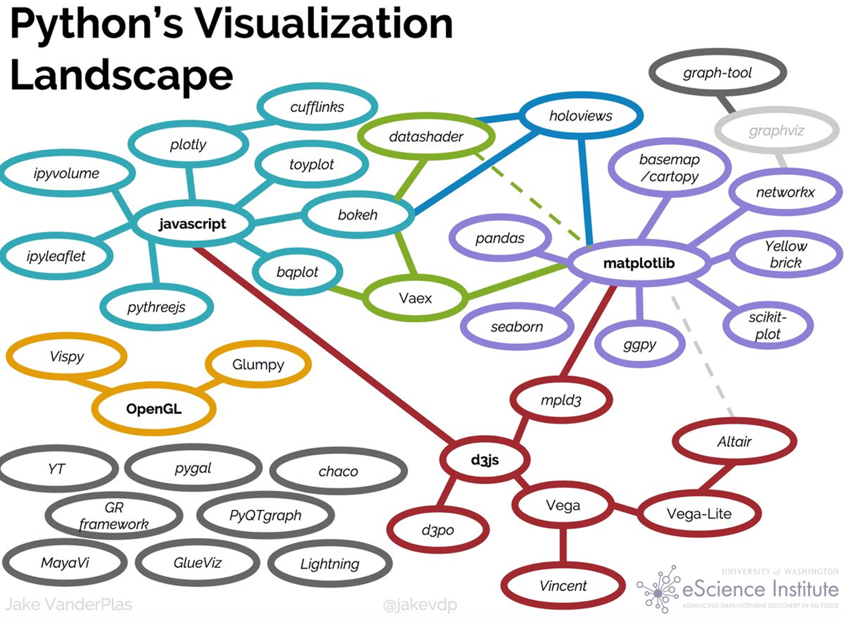
Notes:
Python offers a large number of visualization libraries. Jake VanderPlas created this overview to help show many of the most popular ones and how they relate to each other.
Jake VanderPlas 2017 talk, The Python Visualization Landscape (https://youtu.be/FytuB8nFHPQ)

Slide 14
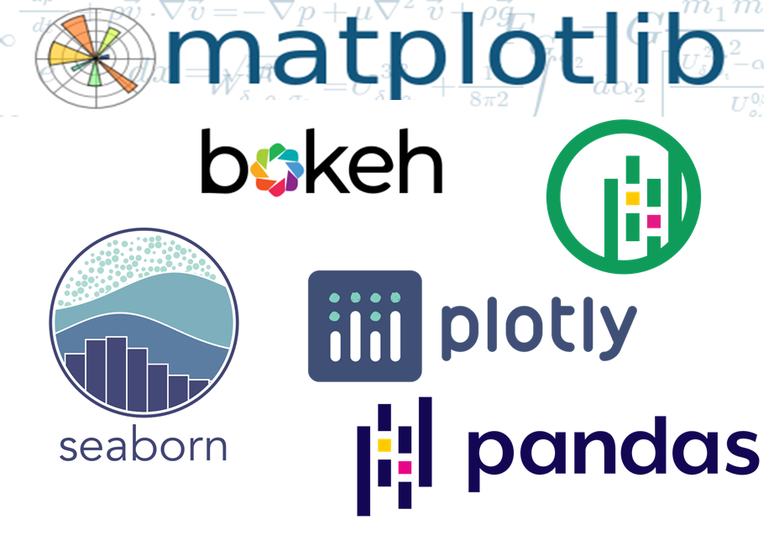
Python Libraries

Slide 15
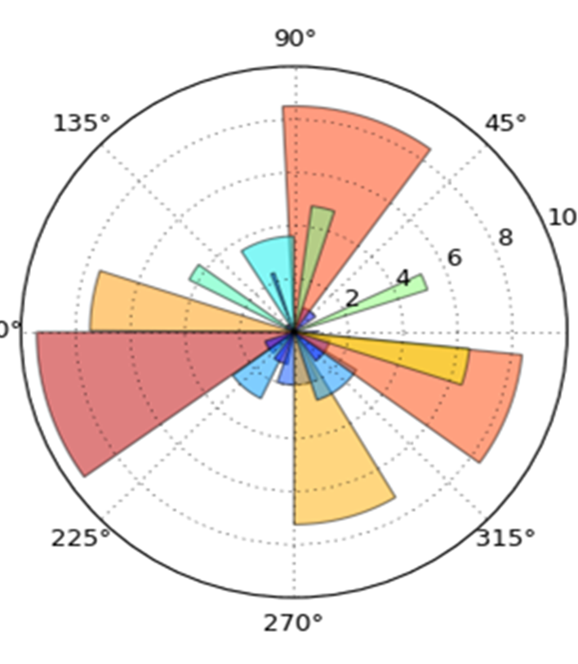
Getting Started with Matplotlib
The most widely used Python plotting library
Serves as the basis for many other visualization libraries
Produces high-quality publication-ready plots

Slide 16
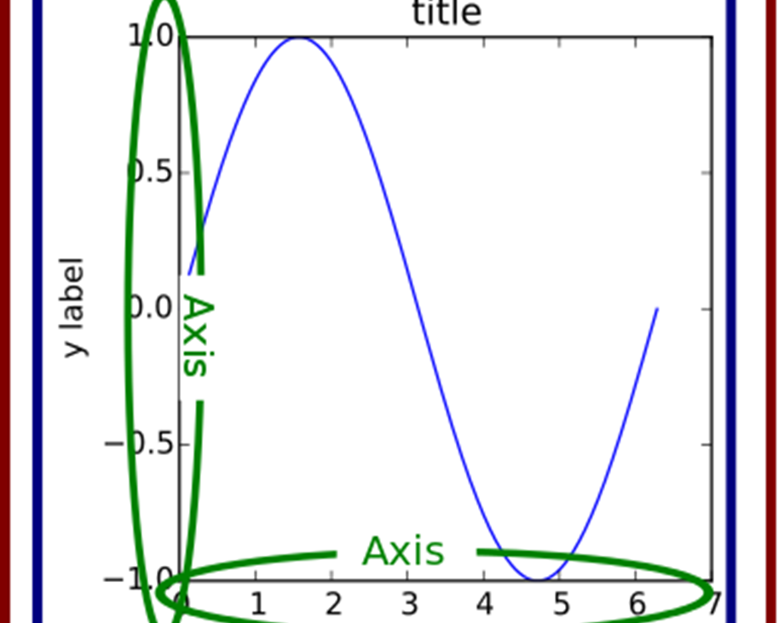
Matplotlib Object Hierarchy
Figure
The outmost container in the object hierarchy
Can contain zero, one, or multiple Axes objects
Axes
A single plot or subplot containing an x-axis and y-axis
Don’t confuse it with “axis”, which refers to the x/y axis of a plot

Slide 17
Python Visualization Walkthrough
Notes:
1_Python_visualization_introduction.ipynb

